Slide 1
Mobile App Development
TALK TO THE CONSULTANTS

Slide 2

EXPERTS IN MOBILE PAYMENT SOLUTIONS
From concept to development, our cutting edge payment solutions enhance your business security while managing all payment related key operations with maximum efficiency. We have designed fast, intuitive and secure mobile apps for all major platforms such as Apple, Android and SenchaTouch.
Our mobile apps are enabled with outstanding functionalities that deliver a secure and smooth experience to the end user. Our key focus is to innovate and reorient your idea with advanced digital applications using a methodological and innovative development strategy.
Notes:
The technologies at the bottom will be edited in the final design as per our discussion

Slide 3
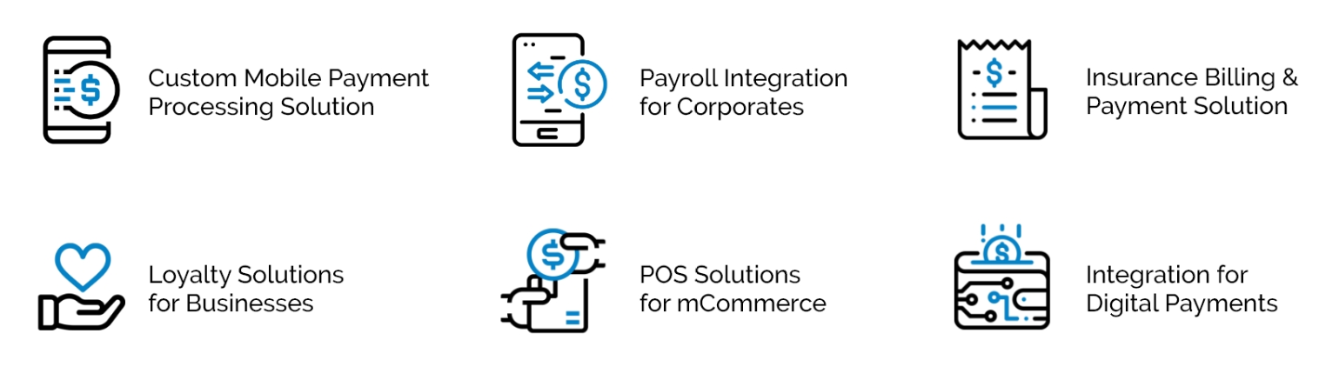
SOLUTIONS IN MOBILE DEVELOPMENT
POS Solutions for Businesses

Slide 4
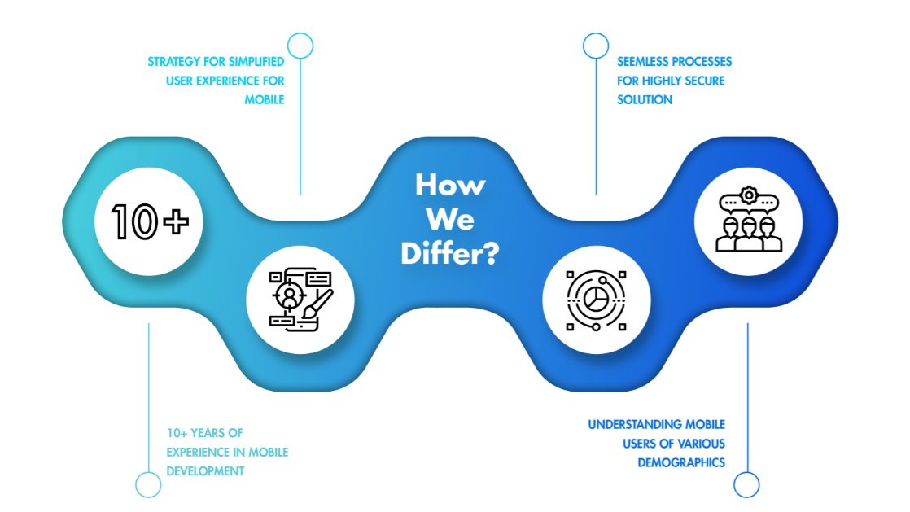
15+
15+ YEARS OF EXPERIENCE IN MOBILE DEVELOPMENT

Slide 5
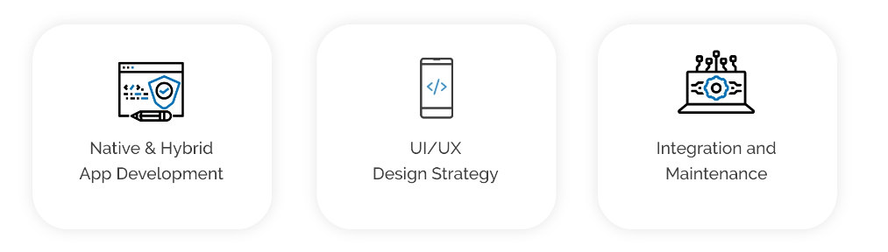
MOBILE APP DEVELOPMENT SERVICES
We leverage our years of experience to offer custom app development and consulting services along with agile development strategies to deliver cutting edge , secure, scalable mobile applications.

Slide 6
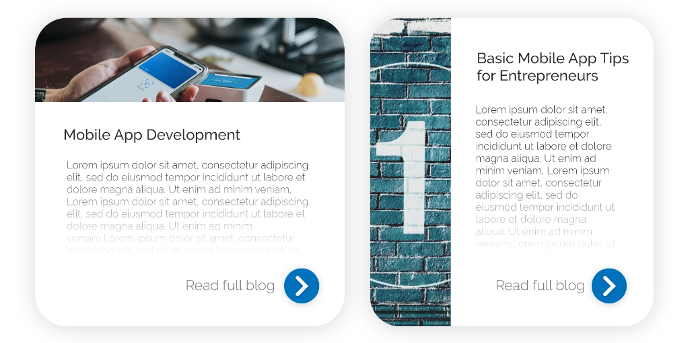
OUR BLOG
Get the latest news and insights as innovative payments apps are fast
becoming the driving force behind security, speed, reliability and efficiency for businesses as well as customers.

Slide 7
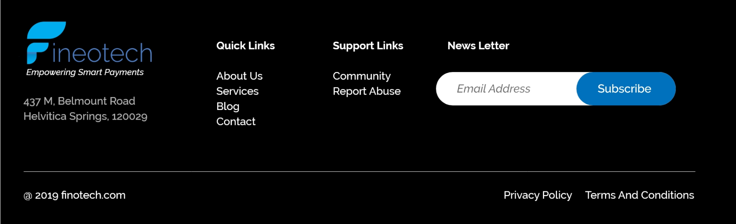
Footer

